Slide 1
Campus Resilience Program Exercise Starter Kit
Tornado Tabletop Exercise
Exercise Conduct Briefing
[Insert Date]

Slide 2
READ FIRST
The purpose of this Exercise Conduct Briefing is to provide a baseline exercise document that institutions of higher education can use to assess their emergency plans, policies, and procedures
The sample content contained in this document can be tailored as necessary by filling in all [bracketed content that is highlighted in red]
To insert the sponsoring organization’s logo, navigate to the “View” menu and select “Slide Master”
This briefing is to be used in tandem with the Tornado Situation Manual and Facilitator Guide so any changes made to this briefing will need to be aligned with those documents
**Delete slide prior to conduct**

Slide 3
Welcome and Introductions
[Name]
[Title]
[Department/Agency/Organization]
[Name]
[Title]
[Department/Agency/Organization]

Slide 4
Administrative Remarks
Cell phone etiquette
Evacuation procedures
Restroom locations

Slide 5
Exercise Schedule
Activity | Time
[Welcome and Introductions] | [00:00 a.m.]
[Exercise Overview] | [00:00 a.m.]
Module 1: Preparedness | [00:00 p.m.]
Break | [00:00 p.m.]
Module 2: Response | [00:00 p.m.]
Break | [00:00 p.m.]
Module 3: Recovery | [00:00 p.m.]
Break | [00:00 p.m.]
[Exercise Hot Wash] | [00:00 p.m.]
[Closing Remarks] | [00:00 p.m.]

Slide 6
Exercise Overview

Slide 7
Exercise Overview
Background:
This Tabletop Exercise (TTX) is made available through the Campus Resilience (CR) Program Exercise Starter Kits
Each Exercise Starter Kit aims to support practitioners and senior leaders from the academic community in assessing emergency plans, policies, and procedures while also enhancing overall campus resilience
Purpose:
This specific Exercise Starter Kit will provide the opportunity to examine preparedness, response, and recovery operations related to an EF3 tornado

Slide 8
Exercise Overview (cont.)
Scope:
This [insert duration]-TTX is divided into three Modules:
Module 1 will examine tornado preparedness efforts
Module 2 will examine response efforts in the aftermath of an EF3 tornado
Module 3 will examine recovery operations following an EF3 tornado
Each Module will consist of two activities:
Scenario Overview: Each Module will contain a detailed overview of the scenario
Facilitated Discussions: Participants will engage in facilitated discussions surrounding a set of discussion questions

Slide 9
READ FIRST
The exercise objectives contained in the following slide(s) are provided as sample objectives
These can be tailored as appropriate to align with the overarching goals and desired outcomes for the exercise
Please note that changes made to these objectives will need to be reflected in the associated Facilitator Guide and Situation Manual for this scenario
**Delete slide prior to conduct**

Slide 10
Exercise Objectives
Operational Coordination: Assess the ability to establish and standardize protocols for integrating whole community partners into a unified and coordinated operational structure during planning, response, and recovery efforts
Physical Protective Measures: Implement and maintain risk-informed countermeasures and policies protecting people, borders, structures, materials, products, and systems associated with key operational activities and acritical infrastructure sectors
Health and Social Services; Mass Care Services: Examine strategies to provide, restore, and improve life-sustaining health, human, and social services within affected populations following a disaster
Public Information and Warning: Review the processes related to disseminating time-critical, operational, and incident-related intelligence and information to the whole community
Infrastructure Systems: Stabilize critical infrastructure functions, minimize health and safety threats, and efficiently restore and revitalize systems and services to support a viable, resilient community

Slide 11
Participant Roles and Responsibilities
Facilitator: Provides situation updates and facilitates discussions
Players: Respond to the situation presented based on current plans, policies, and procedures
Observers: Visit or view selected segments of the exercise without directly engaging in exercise discussions
Support Staff: Performs administrative and logistical support during the exercise (e.g., registration)
[Insert additional participant roles as appropriate]

Slide 12
Participating Organizations
[Insert Participating Organization]
[Insert Participating Sub-Organization]
[Insert Participating Organization]
[Insert Participating Sub-Organization]
[Insert Participating Organization]
[Insert Participating Sub-Organization]

Slide 13
Exercise Guidelines
This exercise is being conducted in an open, low-stress, no-fault environment; varying viewpoints, even disagreements, are expected
Act in real-world roles for your institution or organization when considering the scenario
Decisions are not precedent-setting; this is an open discussion
The focus should be on identifying suggestions and recommended actions for improving preparedness, response, and recovery efforts
[Insert any additional guidelines that may be relevant to the exercise]

Slide 14
Assumptions and Artificialities
The exercise scenario is plausible and events occur as they are presented
Players will use existing plans, policies, procedures, and resources to guide responses
There is no “hidden agenda” nor are there any trick questions
The scenario assumes certain player actions as it moves through each phase; players should first discuss the actions stipulated by the scenario
Players are welcome to engage in “what if” discussions of alternative scenario conditions
[Insert any additional assumptions or artificialities that may be relevant to the exercise]

Slide 15
Start of Exercise

Slide 16
Module 1: Preparedness

Slide 17
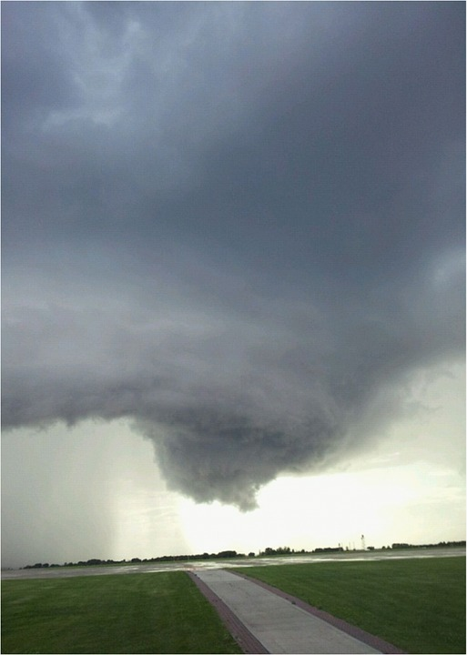
Module 1: Scenario Overview
[Insert Date and Time]
A large system of severe thunderstorms begins moving into your area; the National Weather Service (NWS) reports that the conditions are favorable for the development of tornados
Later that day, a large tornado is reported to have passed north of your area, devastating parts of the affected town
Figure 1: Funnel Cloud Forms
Local and state media report more than a dozen missing persons and several fatalities, in addition to significant damage to buildings, roads, and power lines
Local officials advise residents of your area to familiarize themselves with tornado safety practices

Slide 18
Module 1: Scenario Overview (cont.)
[Insert Date and Time]
The NWS issues a Tornado Watch for your town, including the area surrounding [insert institution name]
Other institutions in the surrounding area begin cancelling classes, athletic events, and social functions, and several of your student groups ask whether they should postpone their own scheduled events
Visiting professors and administrators who had been invited to an academic conference call to ask whether it is safe to travel to your institution
Faculty members and students express concern over the impact of power outages or systems damage on research equipment and perishable materials

Slide 19
Module 1: Discussion Questions (1/4)
Operational Coordination
What plans, policies, and procedures does your institution have in place to prepare for a tornado?
Who in your organization is responsible for monitoring NWS alerts or would likely receive a bulletin from some other alerting authority?
What are your institution’s initial priorities after a Tornado Watch has been issued?
How would your institution establish a command structure to coordinate your preparedness and mitigation efforts?
What resource gaps could limit your institution’s ability to prepare for a tornado?
[Insert additional discussion questions as appropriate]

Slide 20
Module 1: Discussion Questions (2/4)
Physical Protective Measures
What risks does a tornado pose to your institution’s key assets and systems (e.g., campus facilities, critical infrastructure)?
What steps can your institution take to protect your critical operations?
What steps can your institution take to mitigate a temporary loss of critical operations?
[Insert additional discussion questions as appropriate]

Slide 21
Module 1: Discussion Questions (3/4)
Health and Social Services & Mass Care Services
Are there identified locations where people should go in the event of a tornado?
What plans, policies, and procedures does your institution have in place to ensure all students, faculty, and staff are safely sheltered in case of a Tornado Warning?
[Insert additional discussion questions as appropriate]

Slide 22
Module 1: Discussion Questions (4/4)
Public Information and Warning
What plans, policies, and procedures does your institution have in place to guide your internal and external communications strategies?
How and when does your institution issue warnings, alerts, and other emergency messaging?
What individual, office, or department coordinates and delivers your institution’s public messaging?
How does your institution encourage students, faculty, and staff to take individual steps to mitigate the potential impacts of a tornado?
How will your institution use social media platforms in support of incident communications and public messaging?
[Insert additional discussion questions as appropriate]

Slide 23
Break

Slide 24
Module 2: Response

Slide 25
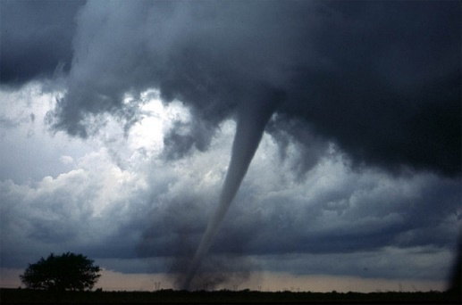
Module 2: Scenario Overview (1/3)
[Insert Date and Time]
The NWS Issues a Tornado Warning for your area
[Insert Date and Time]
Fifteen minutes later, a large tornado passes through the [insert institution name] campus, causing immediate power outages and structural damage to several academic and administrative buildings
Figure 2: Tornado Making Landfall
The wind funnel also sweeps through parking lots, tearing cars apart and littering the campus with debris
Uprooted trees and airborne debris sever power lines, obstruct nearby roads, and cause additional structural damage to [insert institution name] buildings

Slide 26
Module 2: Scenario Overview (2/3)
[Insert Date and Time]
In the immediate aftermath of the tornado, your institution receives multiple unconfirmed reports of students trapped beneath the rubble of damaged buildings
Many faculty members and students have suffered injuries that require treatment or hospitalization, and at least six people are currently unaccounted for, including two students with access and functional needs and one international student
Large sections of the [insert academic building] roof have caved in, and portions of the [insert institution name] dining hall as well as several residential buildings have suffered significant structural damage

Slide 27
Module 2: Scenario Overview (3/3)
Large quantities of debris and several uprooted trees have blocked [insert nearby road], limiting access to your institution and delaying response operations
In addition to communication disruptions, downed power lines have resulted in widespread power outages throughout the area, including in most of your institution’s residential buildings
[Insert Date and Time]
The two students with access and functional needs, the international student, and three members of staff, have not yet been located
Furthermore, your institution learns that a hospitalized student has died from injuries sustained during the tornado
After local media reports several more tornado-related fatalities within your area, your institution receives a flood of calls and emails from anxious families who have been unable to contact their children

Slide 28
Module 2: Discussion Questions (1/4)
Operational Coordination
What are your institution’s initial priorities after a Tornado Warning is issued?
What plans, policies, and procedures does your institution have in place to guide response efforts?
How would your institution establish and maintain an effective command structure to coordinate emergency response efforts?
How do key decision-makers collect information on damages and critical needs?
What resources are currently available?
Who are the key external stakeholders that would support response efforts?
[Insert additional discussion questions as appropriate]

Slide 29
Module 2: Discussion Questions (2/4)
Infrastructure Systems
How will your institution facilitate the speedy restoration of critical infrastructure systems and services?
How would your institution coordinate the restoration of critical infrastructure?
What mechanisms does your institution implement to ensure continuity of operations during this response period?
How does your institution collect real-time updates on the status of its critical infrastructure?
[Insert additional discussion questions as appropriate]

Slide 30
Module 2: Discussion Questions (3/4)
Mass Care Services
Who is responsible for tracking injuries, fatalities, and missing persons in the aftermath of a tornado?
What plans, policies, and procedures does your institution have in place to ensure the life safety and health of all students, faculty, and staff?
What resource gaps could limit your institution’s ability to provide mass care services?
What emergency housing plans, policies, and procedures does your institution have in place?
What resource gaps could limit your institution’s ability to meet your community’s emergency housing needs?
[Insert additional discussion questions as appropriate]

Slide 31
Module 2: Discussion Questions (4/4)
Public Information and Warning
How does your institution ensure consistent and coordinated public messaging throughout the initial response period?
How does your institution ensure timely and accurate situational updates for internal stakeholders throughout the response period?
Does your institution have a crisis communications plan or other means of communicating with all stakeholders in case of a breakdown of standard communications?
How does your institution notify families, key stakeholders, and the public of fatalities or serious injuries?
[Insert additional discussion questions as appropriate]

Slide 32
Break

Slide 33
Module 3: Recovery

Slide 34
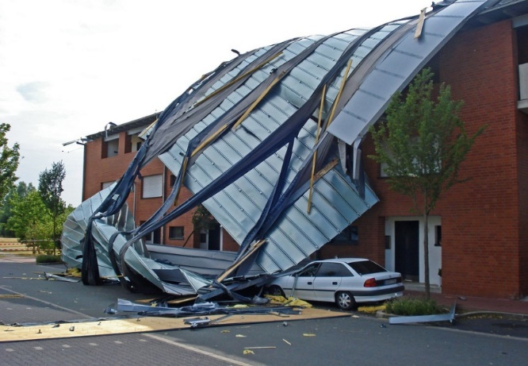
Module 3: Scenario Overview
[Insert Date and Time]
Roughly 48 hours later, a NWS storm survey team classifies the tornado as an EF3
Roadways leading to and from your institution remain partially clogged with debris, worsening traffic and causing several accidents
Figure #3: Tornado Damage
Power outages continue across your campus; additionally, multiple academic and administrative buildings require repairs and some student housing facilities remain uninhabitable
All six missing persons have been recovered and hospitalized for injuries sustained during the tornado; there have been an additional [insert number] fatalities among faculty and staff, and [insert number] remain in critical condition

Slide 35
Module 3: Scenario Overview (cont.)
[Insert Date and Time]
Over the course of the following week, students and families contact faculty and staff asking how class cancellations will impact their academic schedules as well as financial requirements and obligations
The families of international students also reach out to their embassies and consulates requesting information on how class cancellations could impact their children’s immigration statuses

Slide 36
Module 3: Discussion Questions (1/4)
Operational Coordination
How does your institution coordinate the transition from response to short-term recovery efforts?
What plans, policies, and procedures does your institution have in place to guide recovery efforts?
What resource gaps could limit your institution’s ability to meet these priorities?
What funding and assistance programs (e.g., FEMA grants) may be available to you and your institution in the aftermath of a significant tornado?
[Insert additional discussion questions as appropriate]

Slide 37
Module 3: Discussion Questions (2/4)
Infrastructure Systems
Which infrastructure systems would your institution prioritize during the recovery period?
How would your institution coordinate the complete restoration of critical infrastructure?
What mechanisms does your institution implement to ensure continuity of operations during this response period?
[Insert additional discussion questions as appropriate]

Slide 38
Module 3: Discussion Questions (3/4)
Mass Care Services & Health and Social Services
What plans, policies, and procedures does your institution have in place to return your campus to a healthy and safe environment?
What long-term housing plans, policies, and procedures does your institution have in place?
What resource gaps could limit your institution’s ability to meet your community’s long-term housing needs?
[Insert additional discussion questions as appropriate]

Slide 39
Module 3: Discussion Questions (4/4)
Public Information and Warning
How does your institution ensure consistent, coordinated public messaging throughout the recovery period?
How does your institution provide internal stakeholders with timely updates concerning recovery efforts?
Who is responsible for monitoring and managing inquiries from affected students, faculty, staff, and alumni?
[Insert additional discussion questions as appropriate]

Slide 40
Break

Slide 41
End of Exercise

Slide 42
Exercise Hot Wash

Slide 43
Hot Wash Overview
This Hot Wash aims to capture the following information based on observations made throughout the exercise:
Overall strengths
Overall areas for improvement
Major takeaways and action items

Slide 44
Closing Remarks
[Name]
[Title]
[Department/Agency/Organization]
[Name]
[Title]
[Department/Agency/Organization]

Slide 45
Adjournment

Slide 46
Campus Resilience Program Exercise Starter Kit
Tornado Tabletop Exercise
Exercise Conduct Briefing
[Insert Date]

