Slide 1
Campus Resilience Program Exercise Starter Kit
Hazardous Material Spill Tabletop Exercise
Exercise Conduct Briefing
[Insert Date]

Slide 2
READ FIRST
The purpose of this Exercise Conduct Briefing is to provide a baseline exercise document that institutions of higher education can use to assess their emergency plans, policies, and procedures
The sample content contained in this document can be tailored as necessary by filling in all [bracketed content that is highlighted in red]
To insert the sponsoring organization’s logo, navigate to the “View” menu and select “Slide Master”
This briefing is to be used in tandem with the Tornado Situation Manual and Facilitator Guide so any changes made to this briefing will need to be aligned with those documents
**Delete slide prior to conduct**

Slide 3
Welcome and Introductions
[Name]
[Title]
[Department/Agency/Organization]
[Name]
[Title]
[Department/Agency/Organization]

Slide 4
Administrative Remarks
Cell phone etiquette
Evacuation procedures
Restroom locations

Slide 5
Exercise Schedule
Activity | Time
[Welcome and Introductions] | [00:00 a.m.]
[Exercise Overview] | [00:00 a.m.]
Module 1: Initial Response | [00:00 a.m.]
Break | [00:00 a.m.]
Module 2: Continued Recovery | [00:00 p.m.]
Break | [00:00 p.m.]
Module 3: Short-Term Recovery | [00:00 p.m.]
[Exercise Hot Wash] | [00:00 p.m.]
[Closing Remarks] | [00:00 p.m.]

Slide 6
Exercise Overview

Slide 7
Exercise Overview
Background:
This Tabletop Exercise (TTX) is made available through the Campus Resilience (CR) Program Exercise Starter Kits
Each Exercise Starter Kit aims to support practitioners and senior leaders from the academic community in assessing emergency plans, policies, and procedures while also enhancing overall campus resilience
Purpose:
This specific Exercise Starter Kit will provide the opportunity to examine response and recovery operations related to a hazardous material (HazMat) spill incident near campus

Slide 8
Exercise Overview (cont.)
Scope:
This [insert duration]-TTX is divided into three Modules:
Module 1 will examine initial response operations in the aftermath of a train derailment and subsequent HazMat incident
Module 2 will examine continued response operations in the aftermath of a HazMat incident
Module 3 will examine short-term recovery operations following a HazMat incident
Each Module will consist of two activities:
Scenario Overview: Each Module will contain a detailed overview of the scenario
Facilitated Discussions: Participants will engage in facilitated discussions surrounding a set of discussion questions

Slide 9
READ FIRST
The exercise objectives contained in the following slide(s) are provided as sample objectives
These can be tailored as appropriate to align with the overarching goals and desired outcomes for the exercise
Please note that changes made to these objectives will need to be reflected in the associated Facilitator Guide and Situation Manual for this scenario
**Delete slide prior to conduct**

Slide 10
Exercise Objectives
Operational Coordination: Assess the ability to establish an effective command structure that integrates all critical stakeholders to ensure campus and community resources are used efficiently to respond to and recover from a hazardous material incident
Mass Care Services: Examine the ability to provide life-sustaining and human services to affected populations at your institution to include hydration, feeding, sheltering, temporary housing, evacuee support, and distribution of emergency supplies in the aftermath of a hazardous material incident
Public Health, Healthcare, and Emergency Medical Services: Assess the ability to coordinate with emergency services personnel to provide lifesaving medical treatment and targeted public health, medical, and behavioral health support to all affected populations on and around campus following a hazardous material incident
Public Information and Warning: Assess the ability to deliver coordinated, actionable, and timely information to critical partners and stakeholders when faced with a hazardous material incident

Slide 11
Participant Roles and Responsibilities
Facilitator: Provides situation updates and facilitates discussions
Players: Respond to the situation presented based on current plans, policies, and procedures
Observers: Visit or view selected segments of the exercise without directly engaging in exercise discussions
Support Staff: Performs administrative and logistical support during the exercise (e.g., registration)
[Insert additional participant roles as appropriate]

Slide 12
Participating Organizations
[Insert Participating Organization]
[Insert Participating Sub-Organization]
[Insert Participating Organization]
[Insert Participating Sub-Organization]
[Insert Participating Organization]
[Insert Participating Sub-Organization]

Slide 13
Exercise Guidelines
This exercise is being conducted in an open, low-stress, no-fault environment; varying viewpoints, even disagreements, are expected
Act in real-world roles for your institution or organization when considering the scenario
Decisions are not precedent-setting; this is an open discussion
The focus should be on identifying suggestions and recommended actions for improving preparedness, response, and recovery efforts
[Insert any additional guidelines that may be relevant to the exercise]

Slide 14
Assumptions and Artificialities
The exercise scenario is plausible and events occur as they are presented
Players will use existing plans, policies, procedures, and resources to guide responses
There is no “hidden agenda” nor are there any trick questions
The scenario assumes certain player actions as it moves through each phase; players should first discuss the actions stipulated by the scenario
Players are welcome to engage in “what if” discussions of alternative scenario conditions
[Insert any additional assumptions or artificialities that may be relevant to the exercise]

Slide 15
Start of Exercise

Slide 16
Module 1: Initial Response

Slide 17
Module 1: Scenario Overview
[Insert Date and Time]
It is the end of the spring semester and many students faculty, and staff members are spending time outside
Consequently, a large percentage of the campus community is outside when a major train collision occurs in the area, causing a tanker car carrying dangerous chemicals to rupture
A gas cloud begins to move throughout the area surrounding your institution
Figure #1: Train Tracks

Slide 18
Module 1: Scenario Overview (cont.)
[Insert Date and Time]
Local 9-1-1 call centers receive a swarm of calls from panicked individuals regarding the gas cloud
Your institution begins to receive calls from concerned students, faculty, and staff in the area
Your health center begins to receive multiple complaints from individuals reporting headaches, dizziness, uncontrollable coughing, and difficulty breathing
[Insert Date and Time]
The local fire department alerts your campus of an ongoing HazMat incident where a train transporting industrial chemicals derailed, releasing an unknown toxic gas into the surrounding environment
By this time, images and videos of the incident rapidly circulate throughout social media

Slide 19
Module 1: Discussion Questions (1/4)
Operational Coordination
How does your institution maintain awareness of hazardous materials that travel near or are stored on your campus?
What plans, policies, and procedures does your institution have in place to guide response efforts during a potential HazMat incident?
How would your institution establish a command structure to coordinate your response efforts?
What resource gaps could limit your institution’s ability to ensure the safety and security of students, faculty, and staff during a HazMat incident?
[Insert additional discussion questions as appropriate]

Slide 20
Module 1: Discussion Questions (2/4)
Mass Care Services
What plans, policies, and procedures does your institution have in place to mitigate the disruption of essential campus services?
What are your institution’s evacuation/shelter-in-place plans, procedures, and protocols?
What resource gaps could limit your institution’s ability to provide mass care services?
[Insert additional discussion questions as appropriate]

Slide 21
Module 1: Discussion Questions (3/4)
Public Health, Healthcare, and Emergency Medical Services
What plans, policies, and procedures does your institution have in place to guide your actions during a campus medical crisis?
At this point in the scenario, what would be your health and medical priorities?
What other immediate actions would your institution take in order to identify and treat on-campus victims of potential chemical exposure?
How does your institution encourage students, faculty, and staff to take individual steps to mitigate the potential impacts of a HazMat incident?
[Insert additional discussion questions as appropriate]

Slide 22
Module 1: Discussion Questions (4/4)
Public Information and Warning
How does your institution ensure consistent and coordinated public messaging throughout the initial response period?
How and when does your institution issue warnings, alerts, and other emergency messaging?
What individual, office, or department coordinates and delivers your institution’s public messaging?
How will your institution use social media platforms in support of incident communications and public messaging?
[Insert additional discussion questions as appropriate]

Slide 23
Break

Slide 24
Module 2: Continued Response

Slide 25
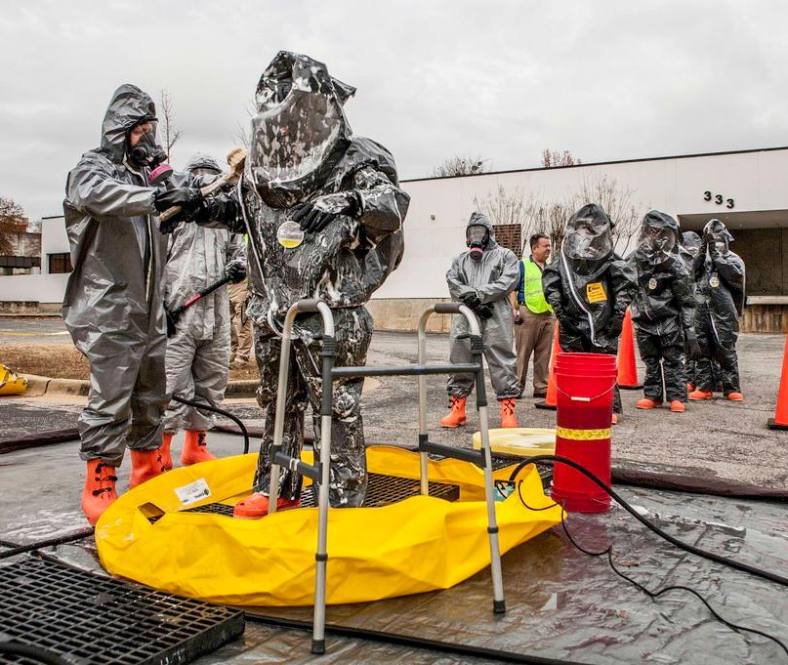
Module 2: Scenario Overview
[Insert Date and Time]
Students, faculty, and staff begin to self-evacuate the area and your institution is inundated with calls from worried parents asking how your institution is responding to the event
The number of patients exhibiting or claiming to exhibit symptoms continues to rise with [insert number] complaints and [insert number] hospitalizations
Figure #2: Decontamination Procedures
Videos of the situation continue to circulate on social media, oftentimes citing incorrect or misleading information
Several post report a “large yellow-green mushroom cloud”

Slide 26
Module 2: Scenario Overview (cont.)
[Insert Date and Time]
First responders confirm that the train was transporting chlorine
Due to shifting wind conditions, additional concerns are raised regarding impacted areas around the region
After extinguishing the fire, first responders begin containment and clean-up operations, but specialists estimate it may take several hours before there is measurable improvement to air quality
Your institution’s health center is overwhelmed with students reporting various symptoms and calls from concerned students, faculty, and staff continue to flow in with questions about what they should be doing to protect themselves

Slide 27
Module 2: Discussion Questions (1/4)
Operational Coordination
How have your institution’s priorities changed as more information about the HazMat incident has become available?
How would your institution maintain an effective command structure to coordinate emergency response efforts?
What resources are currently available?
Who are the key external stakeholders that would support response efforts?
[Insert additional discussion questions as appropriate]

Slide 28
Module 2: Discussion Questions (2/4)
Mass Care Services
How have your mass care priorities changed as the HazMat incident unfolds?
How would your institution track hospitalizations, fatalities, and self-evacuations?
How will your institution account for students, faculty, staff, and campus visitors in affected areas?
What emergency housing plans, policies, and procedures does your institution have in place?
In addition to housing, what other services will your institution need to provide for the duration of this incident?
[Insert additional discussion questions as appropriate]

Slide 29
Module 2: Discussion Questions (3/4)
Public Health, Healthcare, and Emergency Medical Services
What unique considerations are there to inform medical response efforts (e.g., the type of hazardous material involved, geographic impacts on chemical dispersal, etc.)?
At this point in the scenario, what are your health and medical priorities?
What resource gaps could hinder your ability to provide emergency healthcare and medical services?
How would your institution coordinate with emergency responders to implement decontamination procedures (e.g., removal and disposal of contaminated clothing, appropriate bathing measures, etc.)?
How will you coordinate with emergency responders and emergency care facilities to identify, locate, and transport sick individuals?
[Insert additional discussion questions as appropriate]

Slide 30
Module 2: Discussion Questions (4/4)
Public Information and Warning
How does your institution ensure consistent and coordinated public messaging throughout this phase of response operations?
How does your institution ensure timely and accurate situational updates for internal stakeholders throughout the response period?
How do your messaging priorities change as you receive more information concerning the HazMat incident?
How does your institution notify families, key stakeholders, and the public of students who have been sick or hospitalized due to the HazMat spill?
How does your institution counteract false or misleading information?
[Insert additional discussion questions as appropriate]

Slide 31
Module 3: Short-Term Recovery

Slide 32
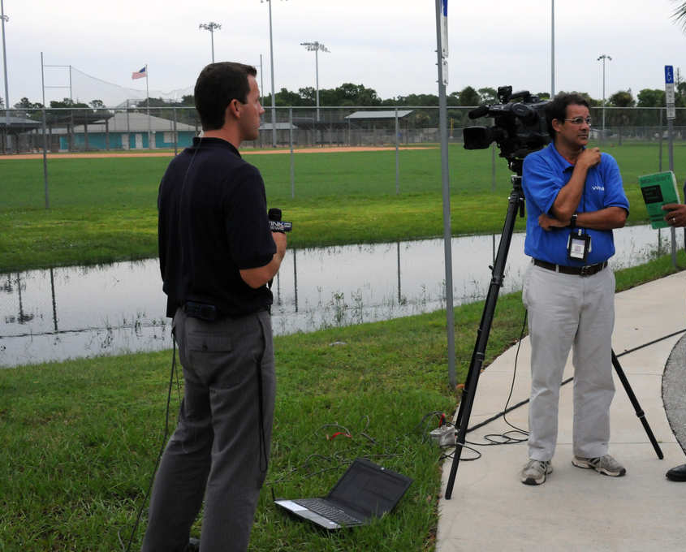
Module 3: Scenario Overview
[Insert Date and Time]
Estimates indicated that full clean-up may now last up to 5 days
In total, [insert number] students, faculty, and staff have reported symptoms of chemical exposure, [insert number] have been hospitalized, [insert number] are in critical condition, and [insert number] have died as a result of their injuries
Figure #3: Media Personnel Conducting Interviews
Some hospitalized students begin speaking with the media regarding the incident
Your institution continues to receive a number of calls asking for information and interviews

Slide 33
Module 3: Scenario Overview (cont.)
[Insert Date and Time]
Emergency response personnel clear the incident site, but there are still some concerns about air quality and safety
Many students, parents, faculty, and staff members have expressed fears over returning to campus; some have noted that they refuse to return altogether
Some staff members have requested temporary work accommodations
Some local businesses have given notice that they will temporarily close as a result of the incident
There is major media coverage of the incident and some stories are criticizing your institution’s ability to respond to the incident

Slide 34
Module 2: Discussion Questions (1/4)
Operational Coordination
How does your institution coordinate the transition from response to short-term recovery efforts?
What plans, policies, and procedures guide your institution’s recovery process?
What resource gaps could limit your institution’s ability to meet these priorities?
[Insert additional discussion questions as appropriate]

Slide 35
Module 2: Discussion Questions (2/4)
Mass Care Services
What plans, policies, and procedures does your institution have in place to return your campus to a healthy and safe environment?
How would your institution provide, track, and communicate these services to members of the campus community who may be geographically dispersed?
What resource gaps could limit your institution’s ability to meet your community’s mass care service needs in the aftermath of this type of incident?
[Insert additional discussion questions as appropriate]

Slide 36
Module 2: Discussion Questions (3/4)
Public Health, Healthcare, and Emergency Medical Services
How would your institution monitor the recovery of students, faculty, and staff?
What are your recovery priorities in terms of providing healthcare and medical services?
Are there processes in place to handle the medical insurance claims for an incident of this magnitude?
What types of information and resources may be available to educate the campus community about the types of impacts to expect from an incident of this type?
[Insert additional discussion questions as appropriate]

Slide 37
Module 2: Discussion Questions (4/4)
Public Information and Warning
How does your institution ensure consistent, coordinated public messaging throughout the recovery period?
How does your institution provide internal stakeholders with timely updates concerning recovery efforts?
Who is responsible for monitoring and managing inquiries from affected students, faculty, staff, and alumni?
Who is responsible for monitoring and managing inquiries from the media?
How does your institution reinforce or restore its reputation in the aftermath of a HazMat incident?
How does your institution continue to combat false or misleading information, particularly through social media?
[Insert additional discussion questions as appropriate]

Slide 38
Break

Slide 39
End of Exercise

Slide 40
Exercise Hot Wash

Slide 41
Hot Wash Overview
This Hot Wash aims to capture the following information based on observations made throughout the exercise:
Overall strengths
Overall areas for improvement
Major takeaways and action items

Slide 42
Closing Remarks
[Name]
[Title]
[Department/Agency/Organization]
[Name]
[Title]
[Department/Agency/Organization]

Slide 43
Adjournment

Slide 44
Campus Resilience Program Exercise Starter Kit
Hazardous Material Spill Tabletop Exercise
Exercise Conduct Briefing
[Insert Date]

